Slide 1
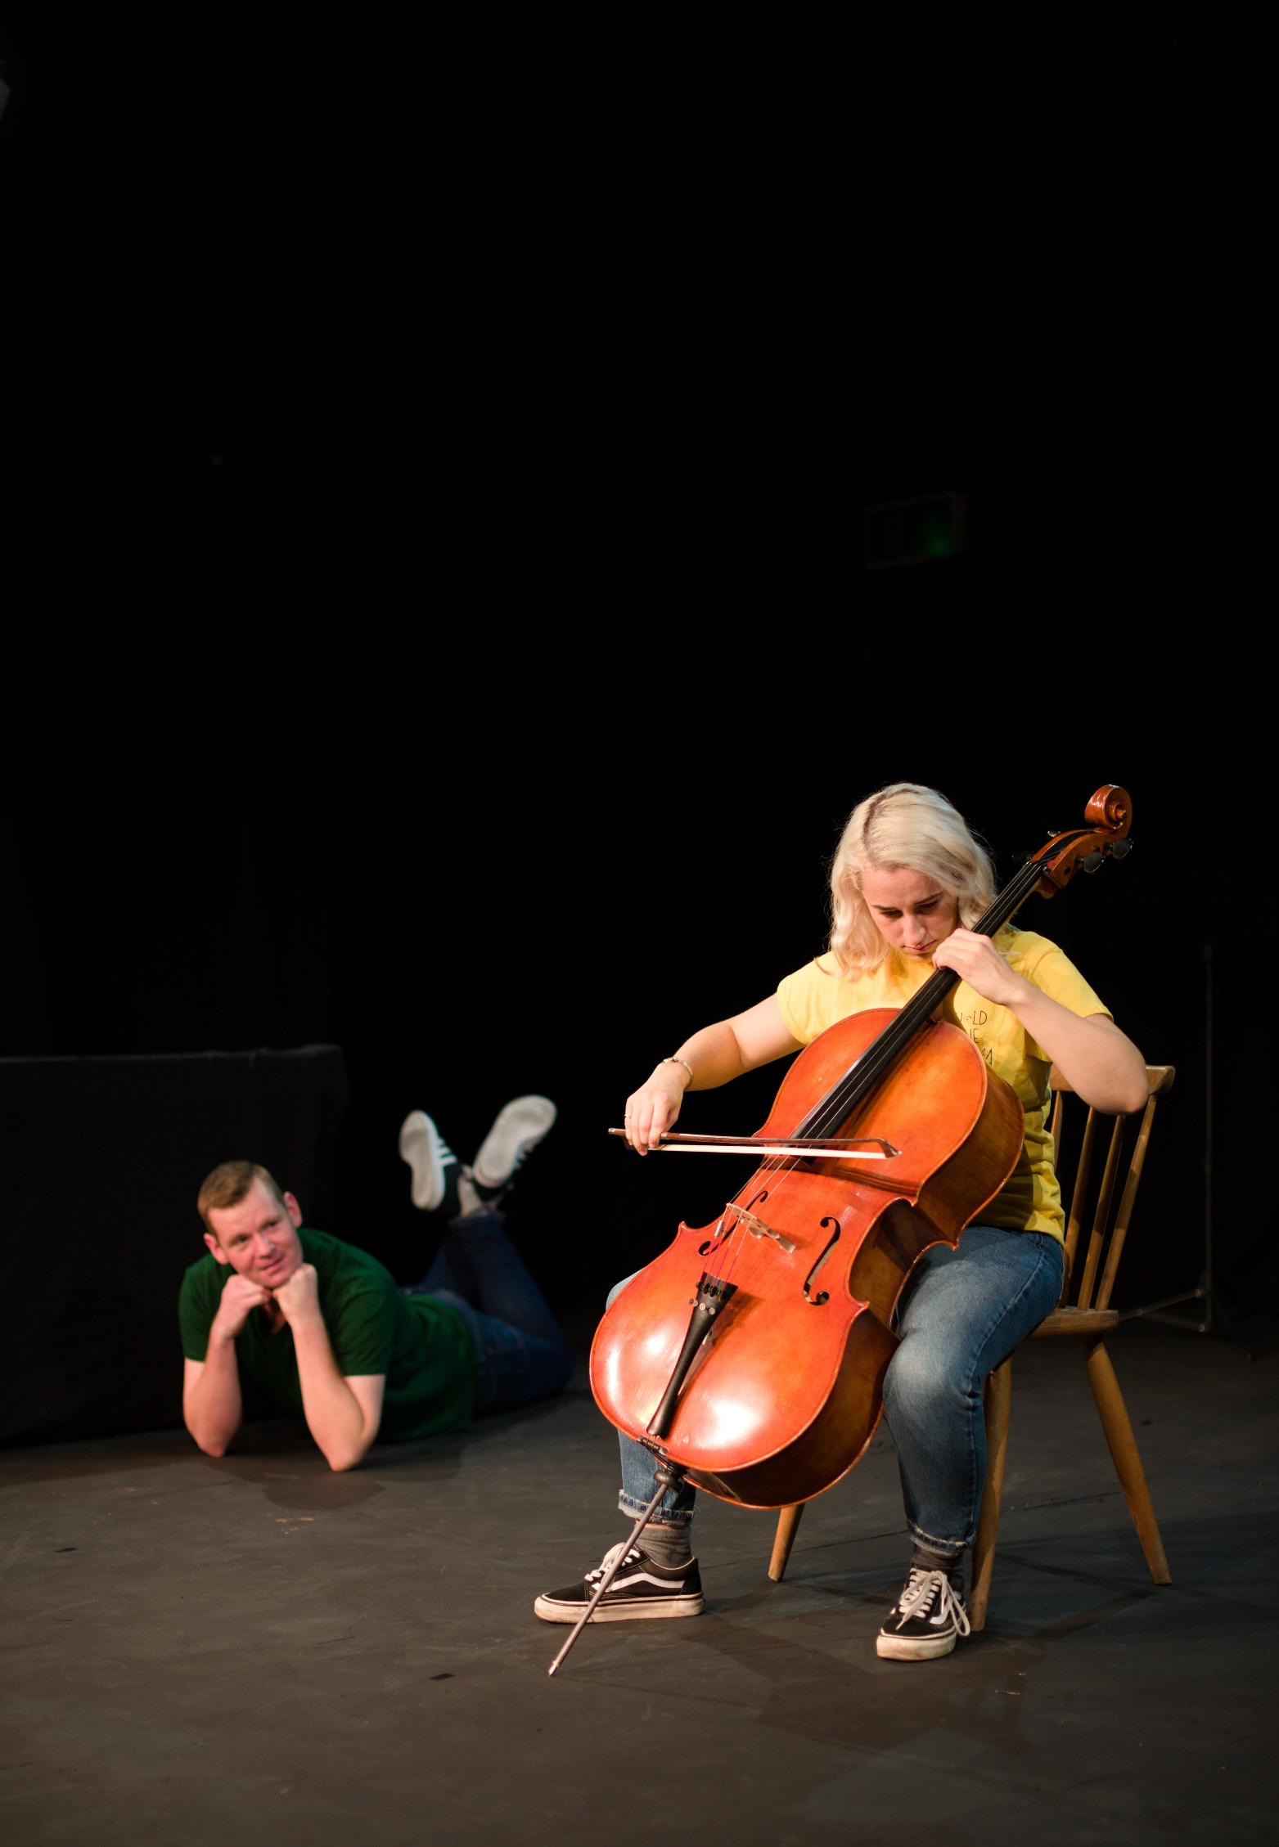

Cover page
Trustee Information Pack

Slide 2
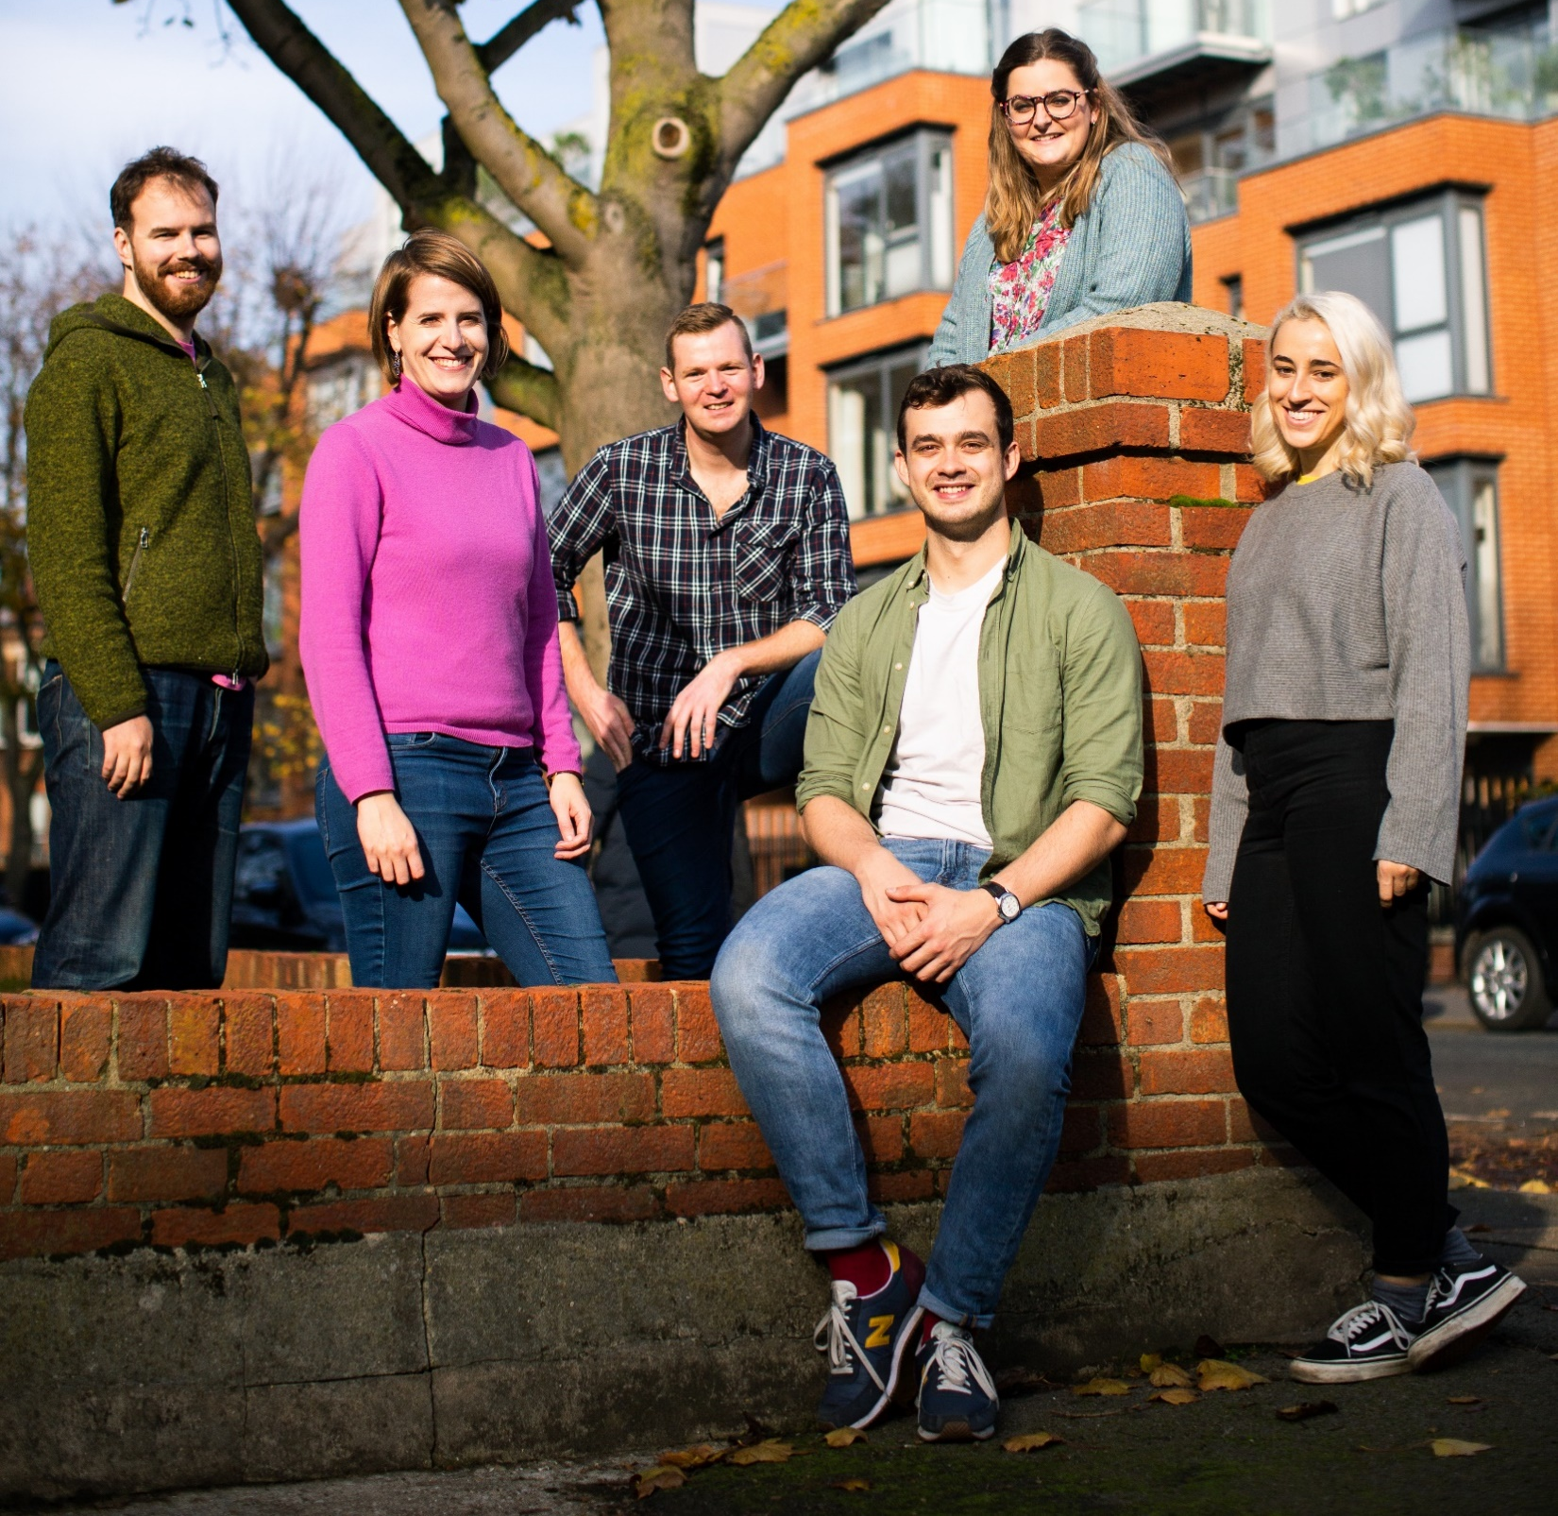
Introducing Hold the Drama
We deliver immersive shows for children that use high-quality live music to tell stories that explore issues around mental health.
Our shows are non-verbal and trust children’s imaginations to make sense of dramatic, visual, and musical cues. We leave space for the children to discuss and articulate the plot in their own words.
Following individual postgraduate study at the Royal Academy of Music, we were brought together as fellows of Open Academy, the conservatoire’s creative learning and participation programme. We created our first show, Stripes, as the culmination of our fellowship year in 2018.
After an initial tour organised in conjunction with Spitalfields Music, we’ve had two successful rounds of lottery funding from Arts Council England, which have allowed us to:
  share our work with more than 4500 children;
  tour Stripes to schools across Waltham Forest;
  develop our performance practice and a second show through a residency at Snape Maltings;
  plan a national tour, subsequently cancelled by COVID;
  replan and rebudget to create Digital Stripes, which is now being shared remotely with schools across the country.

Slide 3
What we do
We use music as a way to start conversations about emotions and feelings. Whether they’ve seen it in person or online, we find that children can both articulate the plot of Stripes and then unpick their own emotional responses with inspiring clarity. It’s particularly moving when children who are otherwise reticent in classroom settings share their understanding—we’ve had teachers in tears, as their pupils demonstrate their ability to interpret dramatic and musical cues. These are just a few of their comments:
Stripes changed how I think about
other people because now I let people
be as different as I let myself, I did
before but now I can do that more and
treat people better.
I learnt that I don’t have to fit
in, I can follow my dreams.
You don’t have to do what
everyone else wants, follow your
heart and do what’s right for you..
We’re not experts in mental health but we take enormous care to frame our discussion and provide supporting materials to teachers so that they can continue and develop the conversations that the show stimulates. Louise Keller, a UKCP & BACP registered child & adolescent psychotherapist, came to watch Stripes at South Grove Primary School during the Waltham Forest Tour:
I had the privilege of seeing Hold the Drama perform to Years 3&4 at Waltham Forest. The children were enrapt from beginning to end and it was incredibly moving to see the whole group burst into spontaneous song as they recognised one of the pieces played. The play is a fantastic vehicle for children to explore important themes around identity, friendship and collaboration.
At a time when the emotional wellbeing of children and development of resilience couldn’t be more pressing, every primary school in the UK would be wise to include Stripes as an essential part of their mental health programme.

Slide 4
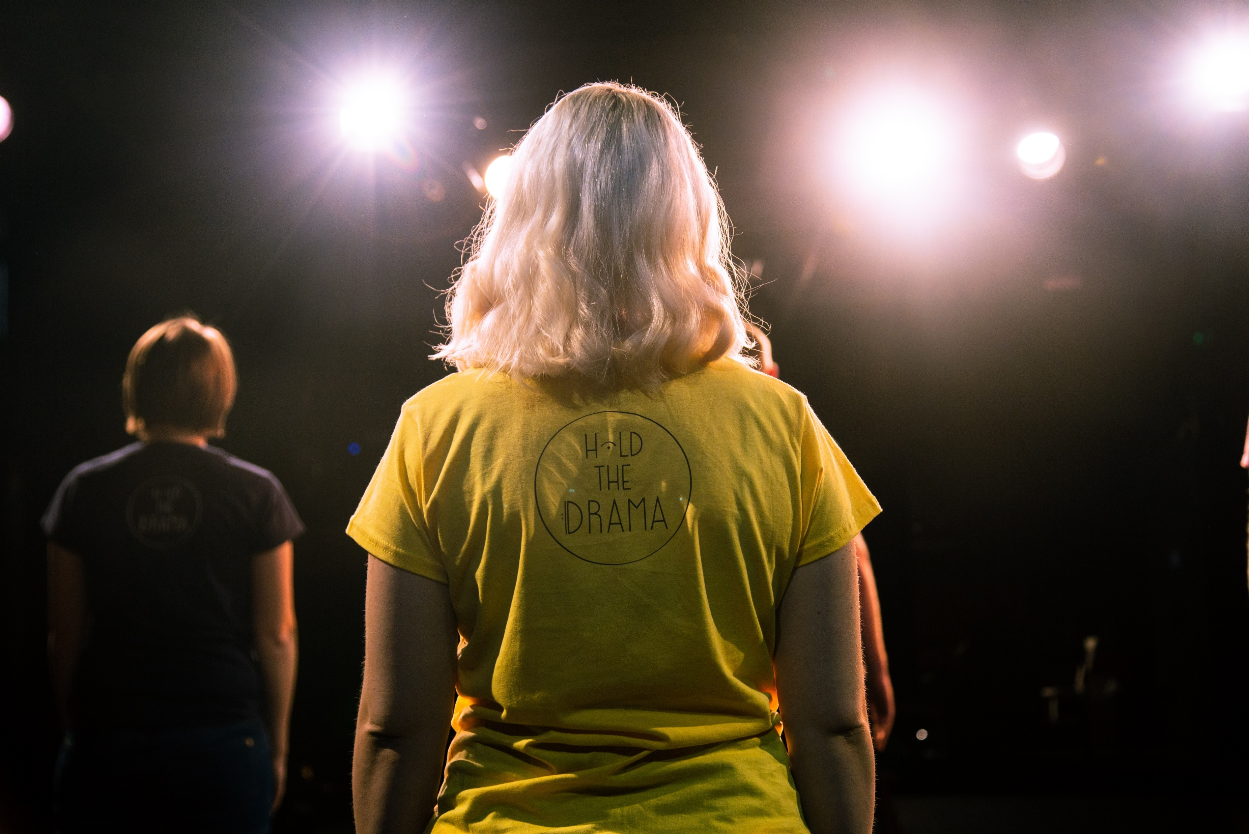
Where we’re going
We want to do more. We’ve been fortunate enough to be able to pivot to delivering Stripes remotely, but COVID has paused much of the work we had planned to complete our second show, reach more children, and provide CPD to teachers that helps them make music and support conversations about emotional wellbeing and mental health.
We’re also in the early stages of discussion with various partners about adapting our work to other contexts, including secondary school children and vulnerable adults. Funding allowing, we will be returning to Snape Maltings in 2022 to complete our second show and working specifically with two groups; young adults in pupil referral units and people living with dementias and their carers.
In order to take the next steps as a group and solidify our future, we are planning to become a Charitable Incorporated Organisation [CIO]. You can read more about the detail of this kind of charitable structure and the role of trustees, but at the most basic level it means that we become a more formally structured organisation, with the benefits and support of a board of trustees and charitable tax relief, including Gift Aid.

Slide 5
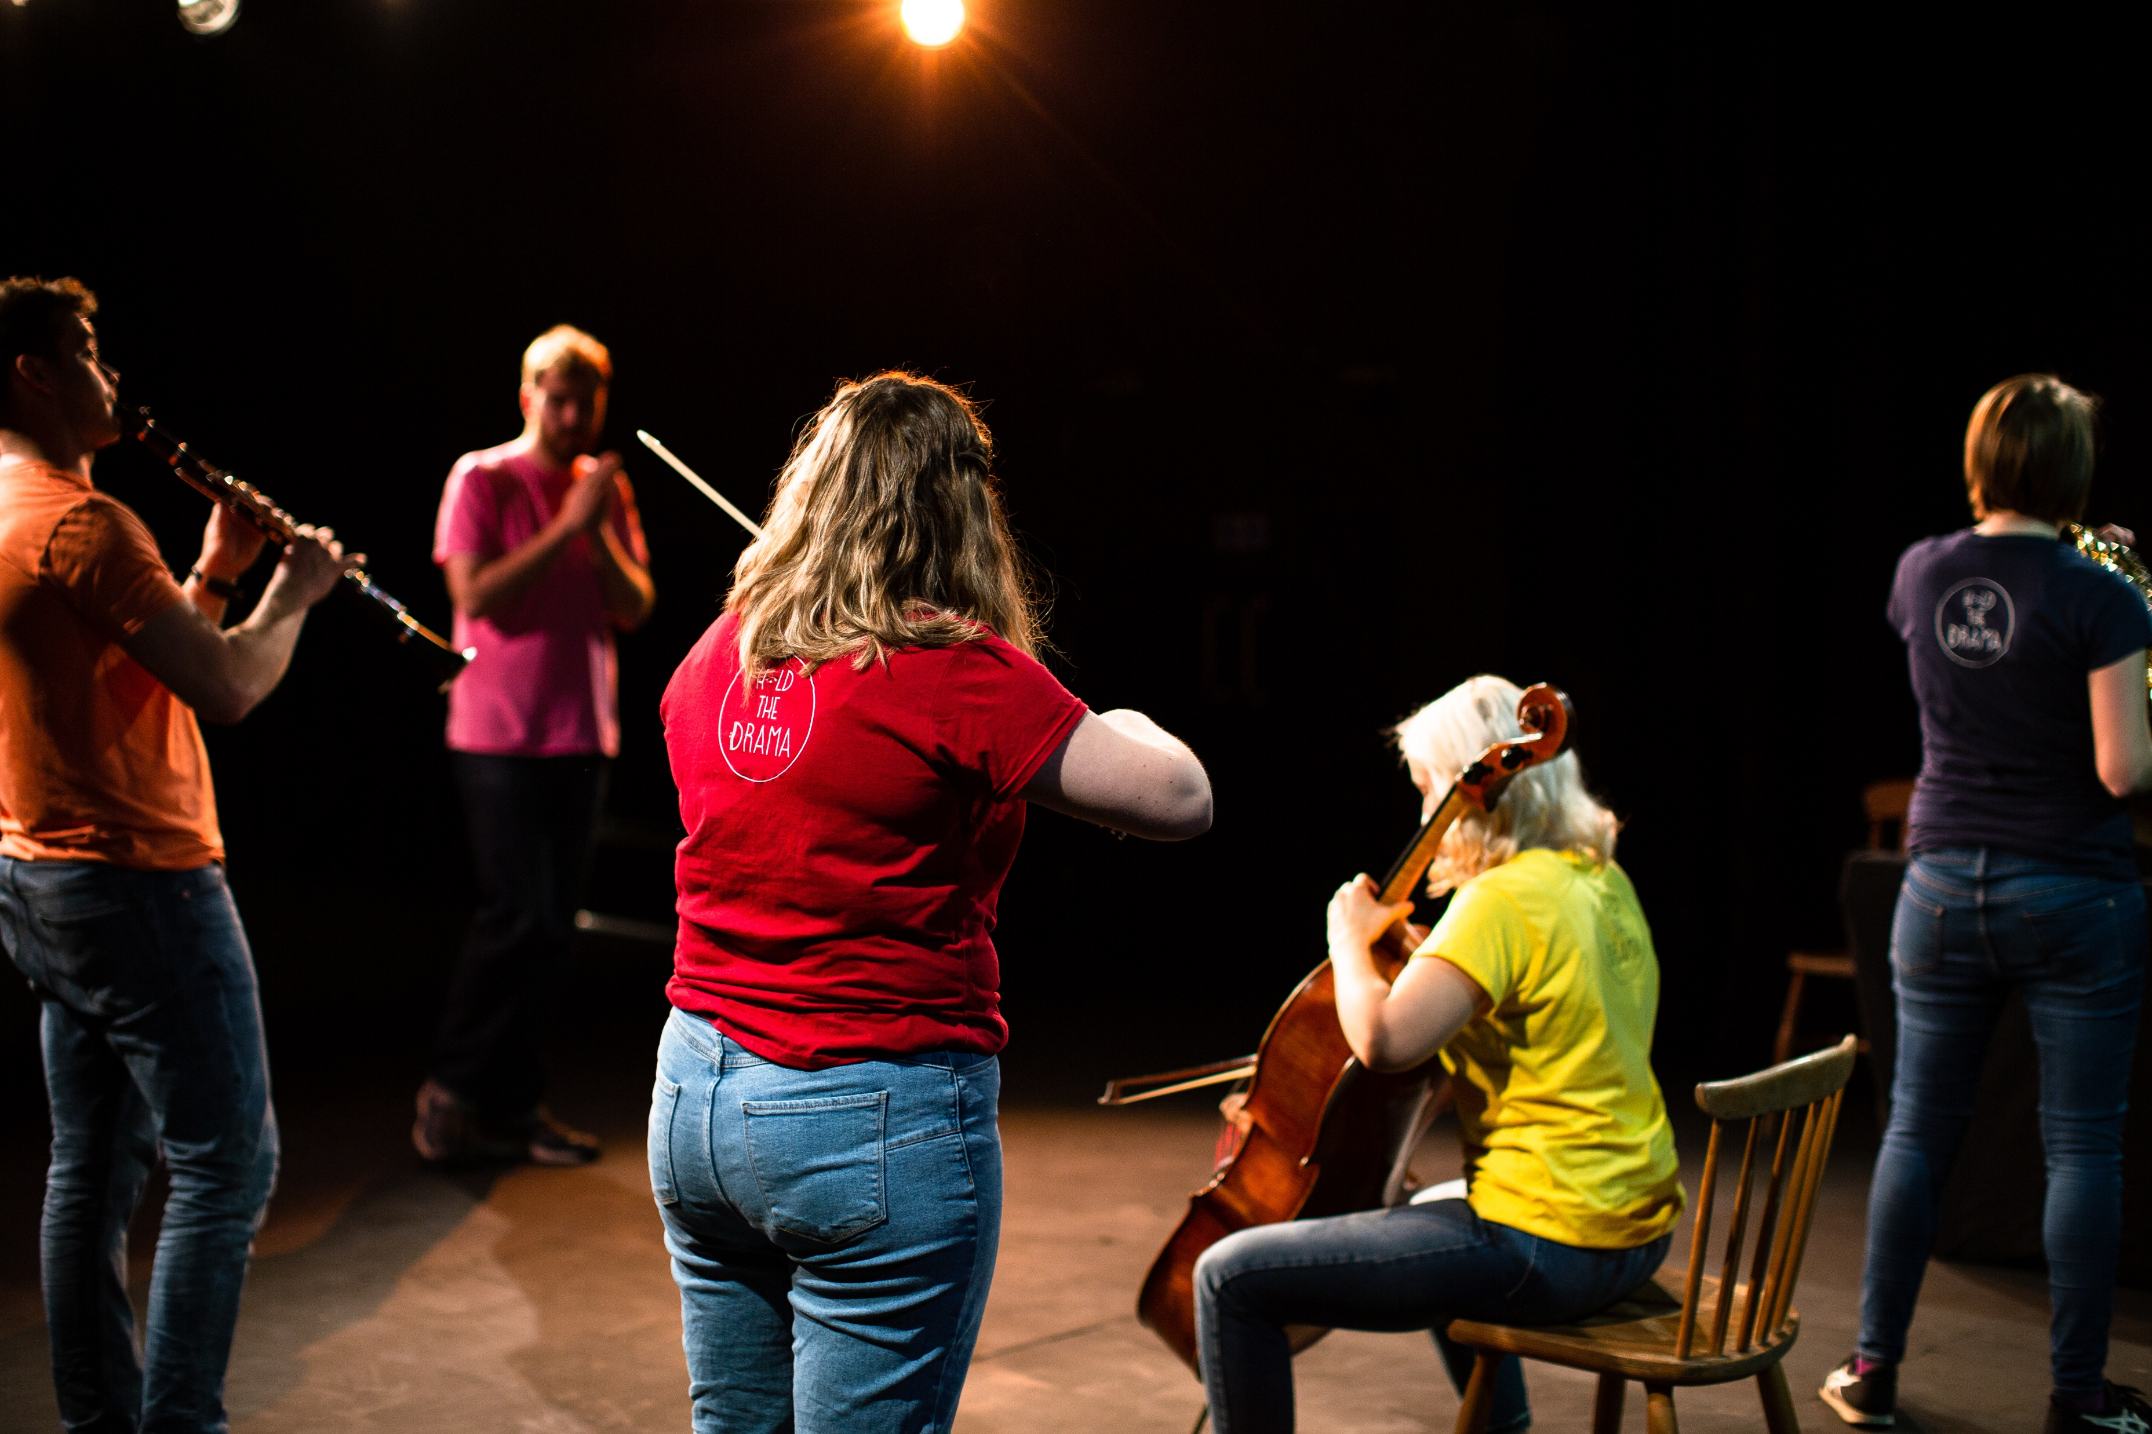
How you could help
We hope you might be interested in helping us to take the next steps, as we become a CIO and establish ourselves in the charitable landscape.
We’re looking for trustees who can:
  be ambassadors for Hold the Drama and for our work;
  help shape the strategic development and governance of Hold the Drama and set charitable objectives;
  connect us with new audiences and sources of funding;
  make sure that resources are used appropriately in the meeting of our charitable objectives and monitored;
  participate in the cycle of meetings that will ensure the smooth and effective running of Hold the Drama.
We’re particularly keen to meet trustees with experience in business or finance.
We plan our operations around school terms but we expect to be flexible in timetabling trustee meetings, both online and in person.

Slide 6
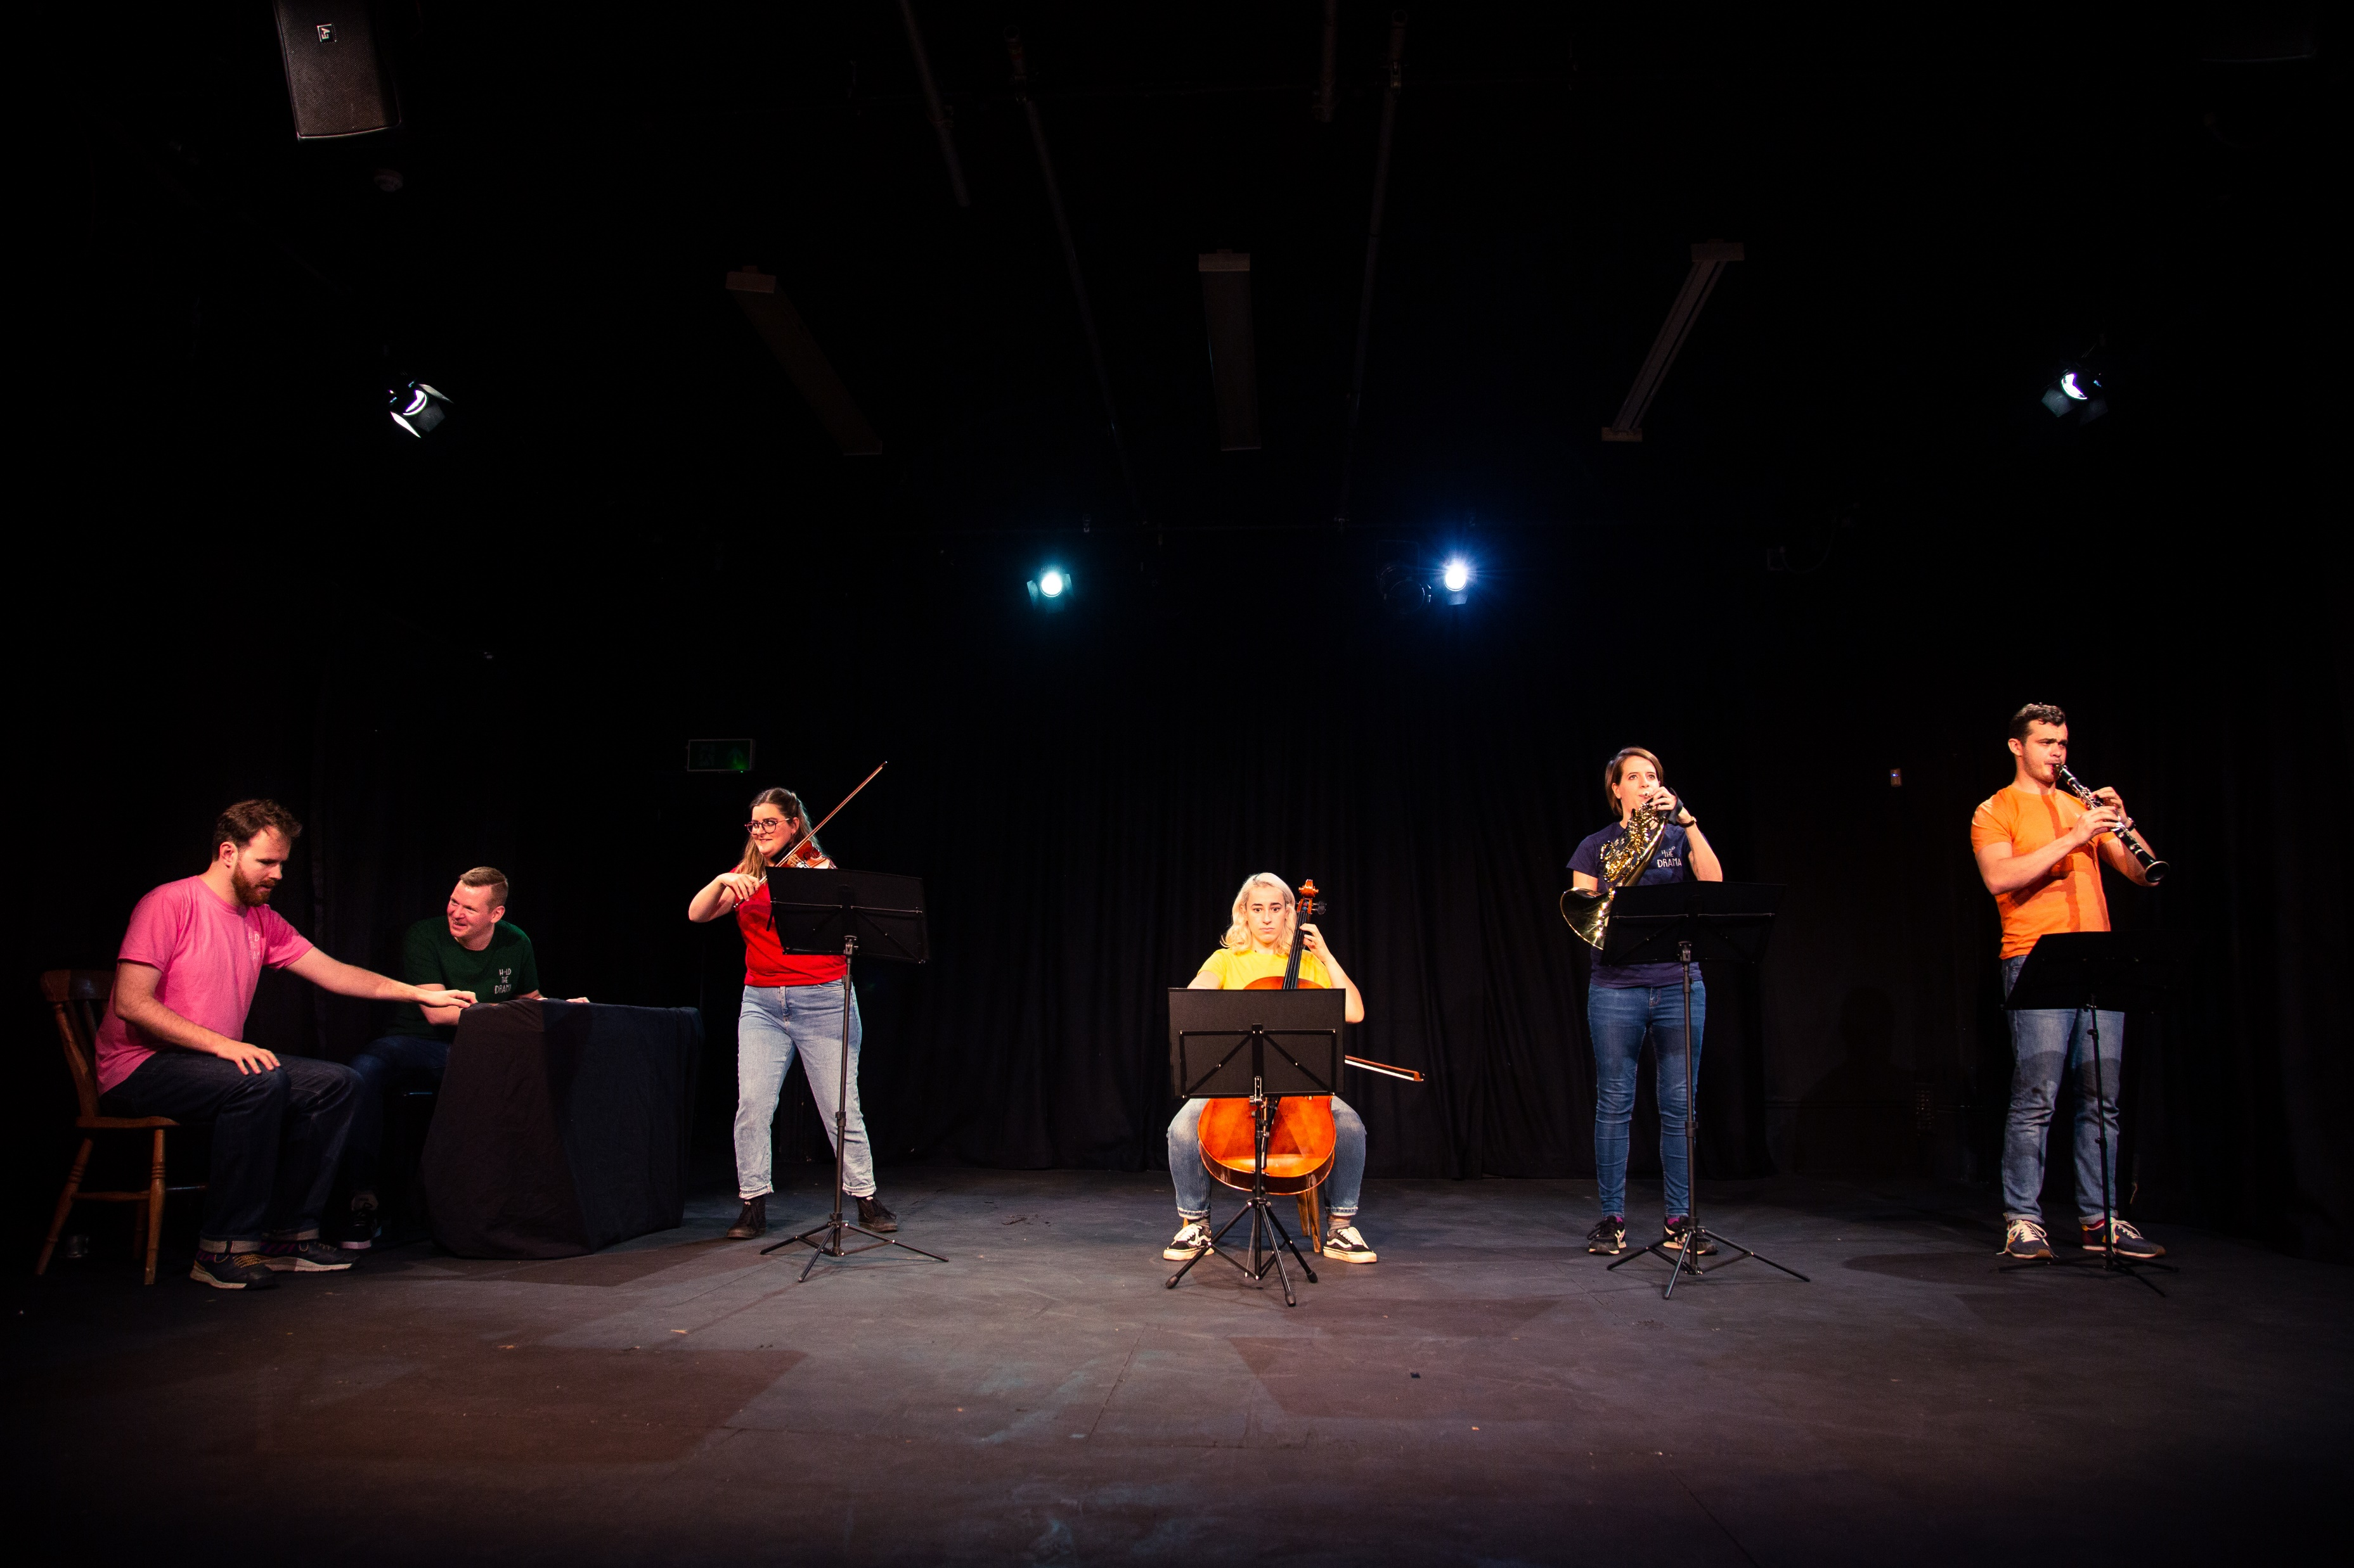
Application process
We hope that what we’ve said piques your interest and that Hold the Drama sounds like an organisation of which you’d like to be part.
If that’s the case, the next steps are very simple:
  Get in touch with us by emailing info@holdthedrama.co.uk and we can arrange an informal chat over the phone, online, or in person as suits you.
  If you’d like to apply directly, then please send us a CV and cover letter telling us about your experience and why you’d like to be one of our trustees.
We’ll respond within five working days to all enquiries and applications, and probably much more quickly than that.
We look forward to meeting you.

